Slide 1
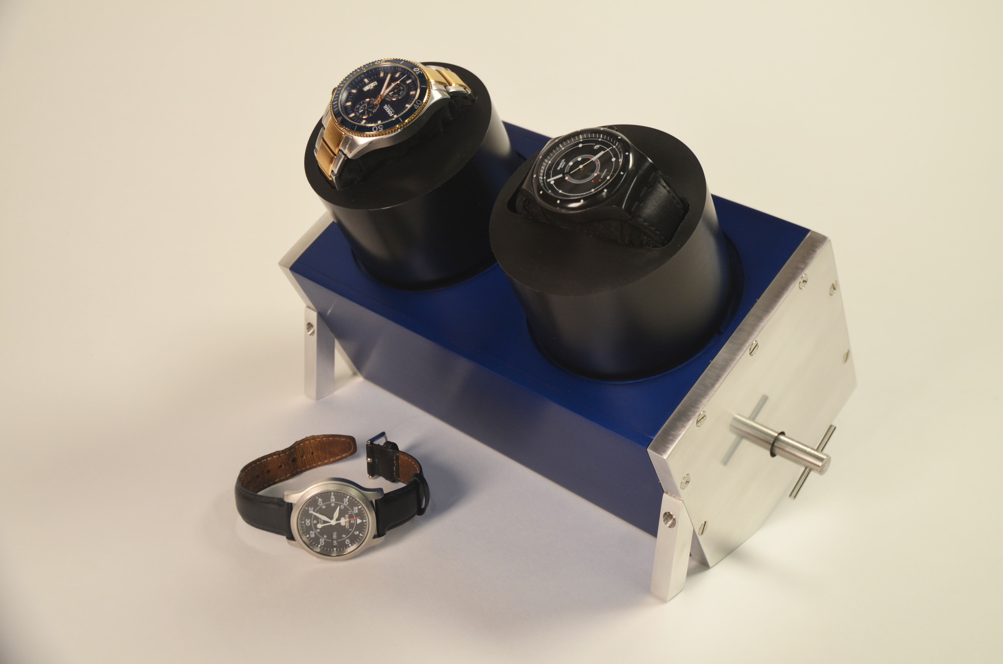
Timekeeper
Natalie Ferrante
Notes:
-The motivation for my project was that I wanted to make a unique gift for my boyfriend, who loves watches, without just getting him another watch
-I decided to build an automatic watch winder, to hold and wind some of his many watches

Slide 2
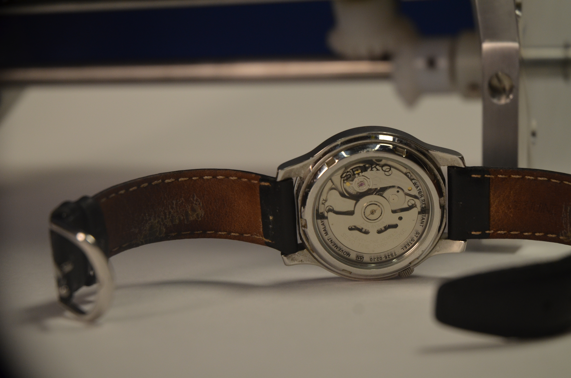
Notes:
-my favorite type of watches are automatic watches with a transparent case back, so you can watch all the cogs turning. Automatic watches have a semicircular rotor that winds the mainspring as the wearer moves their wrist, so you never have to manually wind your watch

Slide 3
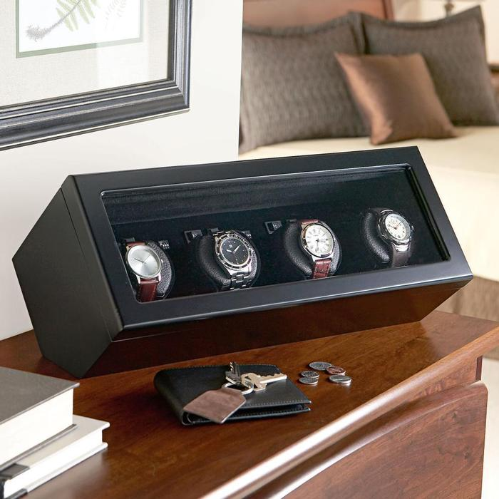
Notes:
-So these winding boxes basically serve to wind your watches when you aren’t wearing them, by rotating them at an angle. Most automatic watch winders are electronic, but I made mine entirely manual for the time being, although I may add electronics later on

Slide 4
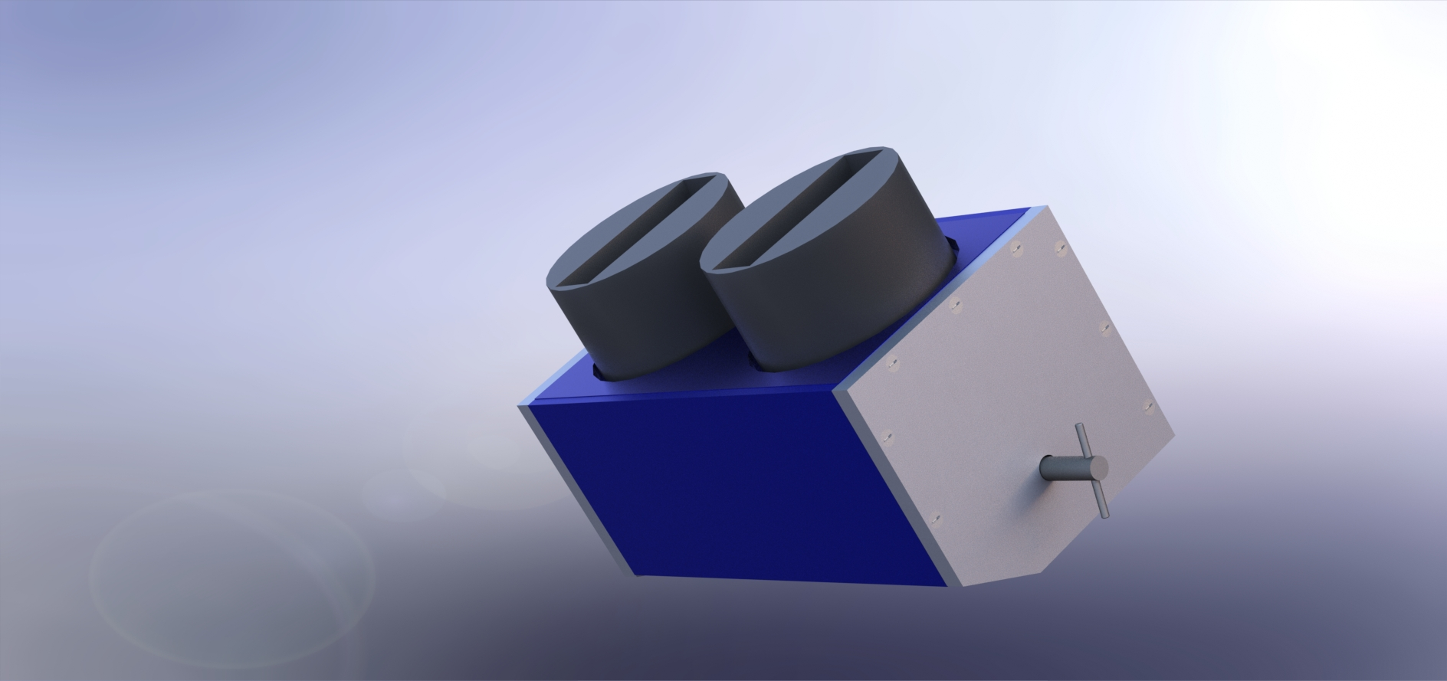
Notes:
-I went through many different ideas for how I wanted it to look. I played with having a lid on it, having a window in the back so you could see the gears, making it have a hexagonal profile… but I finally ended up with this design in my final CAD model, after I factored in the many different things I would have to machine and how much time I had. The three plates covering the middle section are aluminum anodized dark blue, the sides are also aluminum with a brushed finish, and the cylinder holders are delrin, so to slide around easily

Slide 5
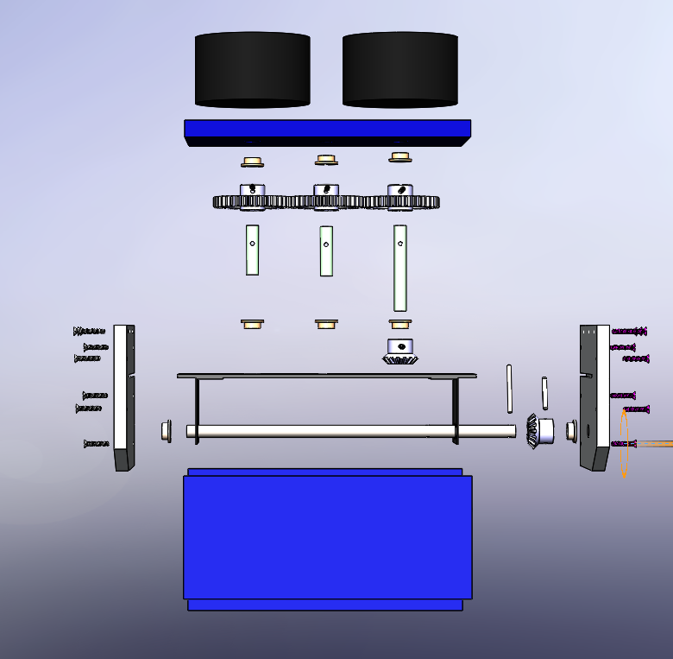
Notes:
-I definitely had my work cut out for me, but I was excited to be able to create something of my own from scratch, and I wanted to learn as much as possible so I was not unhappy with the fact that I would be spending a good deal of time in the machine shop

Slide 6
Notes:
- I believe I ended up with about 11 or 12 separate pieces that I had to machine, not including the bushings that I ended up reaming out because the inner diameter was undersized. I was on the mill and the lathe for almost the entire project

Slide 7
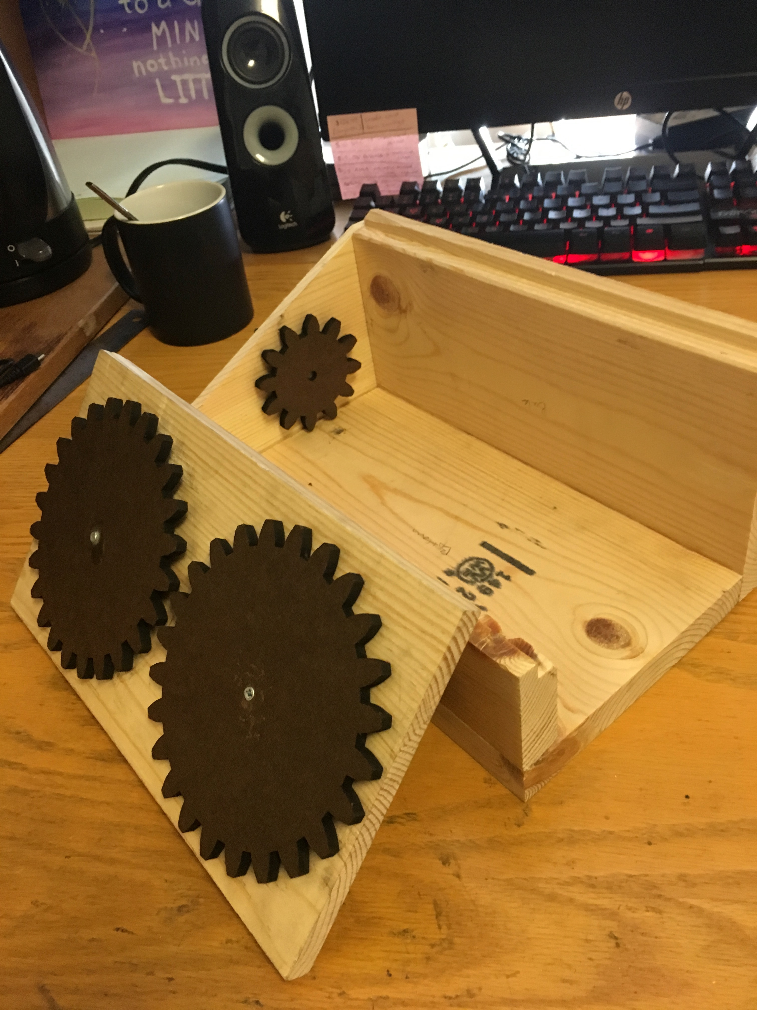
Notes:
-I started with the gears. So as it turns out, gears are difficult sometimes. I did not think that my gear system would be as extensive as it ended up in the end. This is my first prototype of what I thought my gears were going to look like

Slide 8
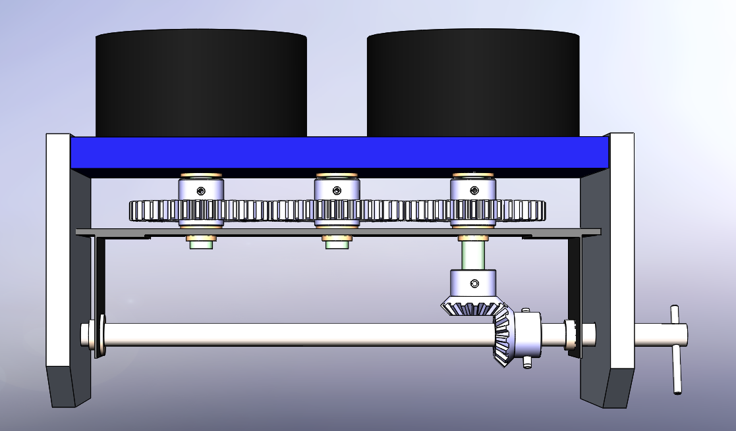
Notes:
-this is what my internal gears ended up being. The gears are purchased because I wanted them to work very smoothly. I had to incorporate bearings for the ends of each shaft, and two miter gears to transfer the torque from the handle. I spent a good deal of time constructing the internal gear system by itself so that it worked properly before I tried to incorporate the outer box

Slide 9
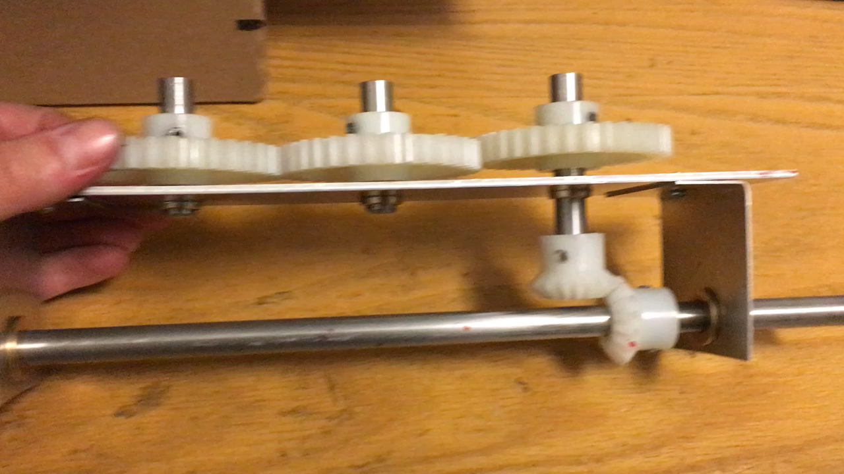
Notes:
-Here are my gears finally working

Slide 10
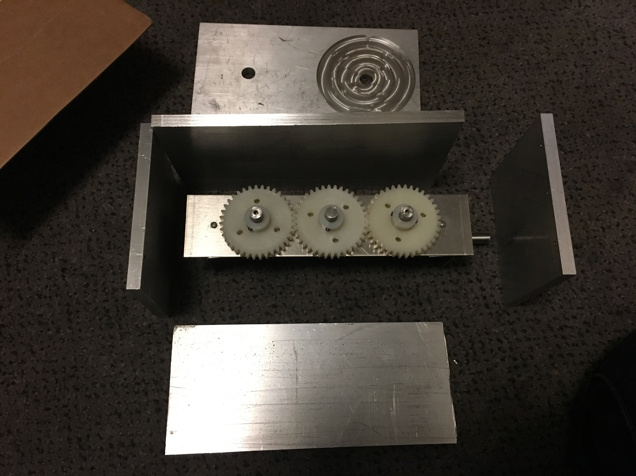
Notes:
-I then went to work on my outer box. It’s mostly a normal rectangle, with the front shorter than the back and the sides have an angle cut from the first corner to tilt forward on. I spent a long time drilling and tapping the holes to fasten the sides of my box together.

Slide 11
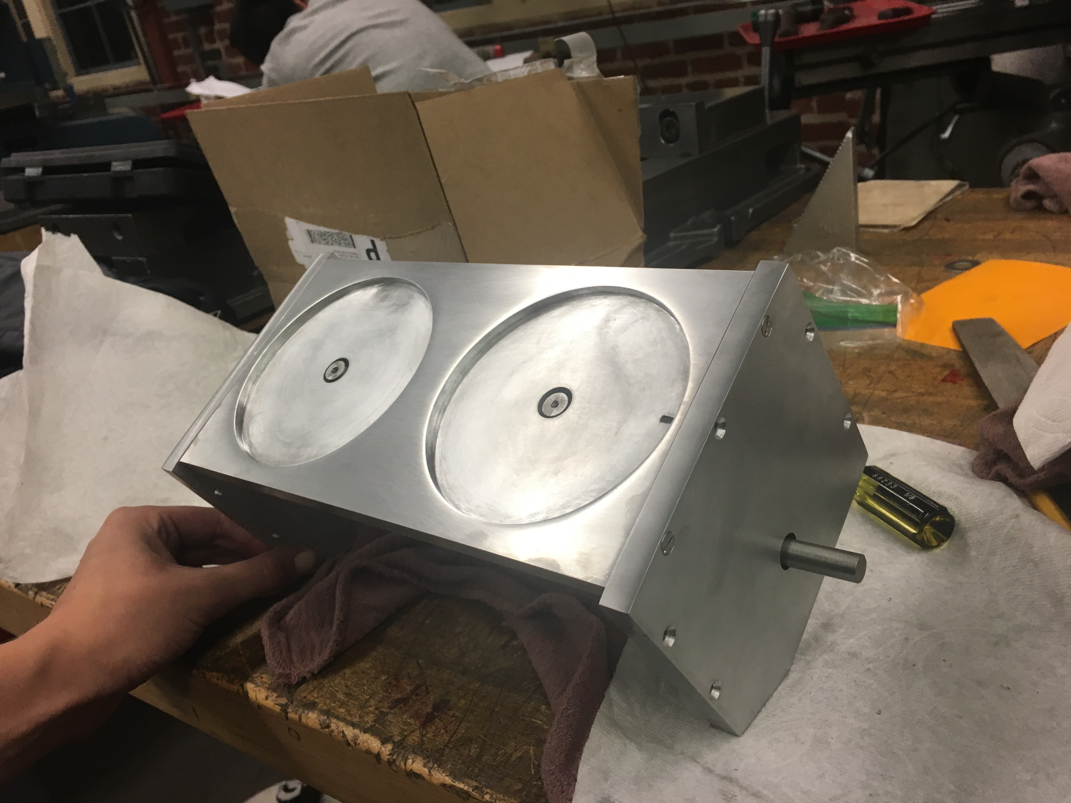
Notes:
- I spent 40 hours in the PRL the week before Thanksgiving break to finish making the outer box, and it still wasn’t quite done by the end of the week. I then spent a good chunk of my Thanksgiving break sanding the top, front and back so that I could anodize them because I felt it was an important part of my final product

Slide 12
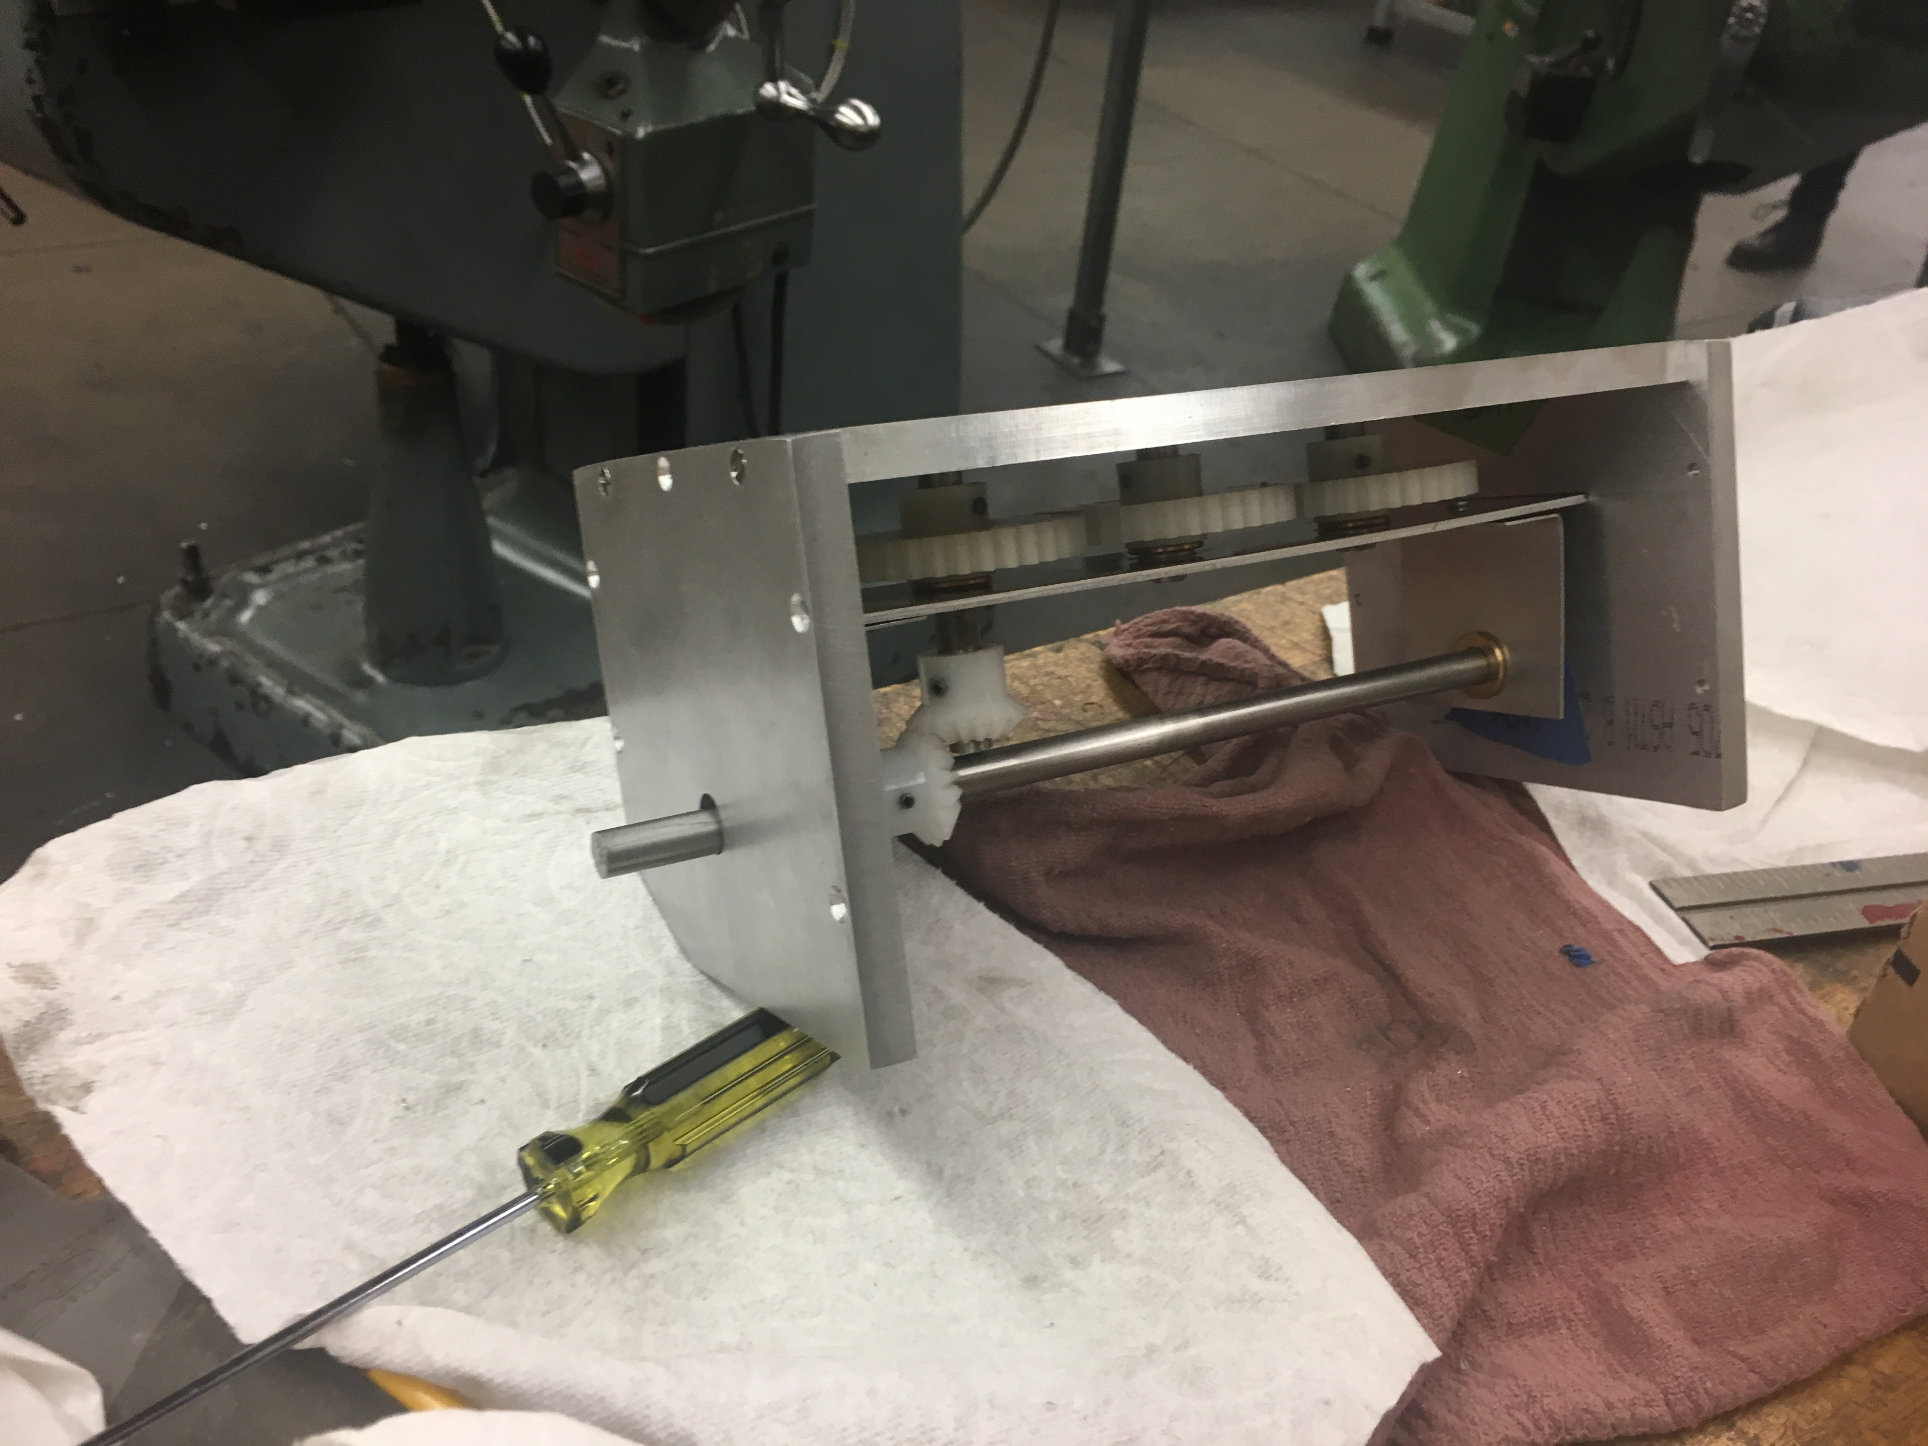
Notes:
-so here it is with the gear system mounted inside, and it has the tilt in it already

Slide 13
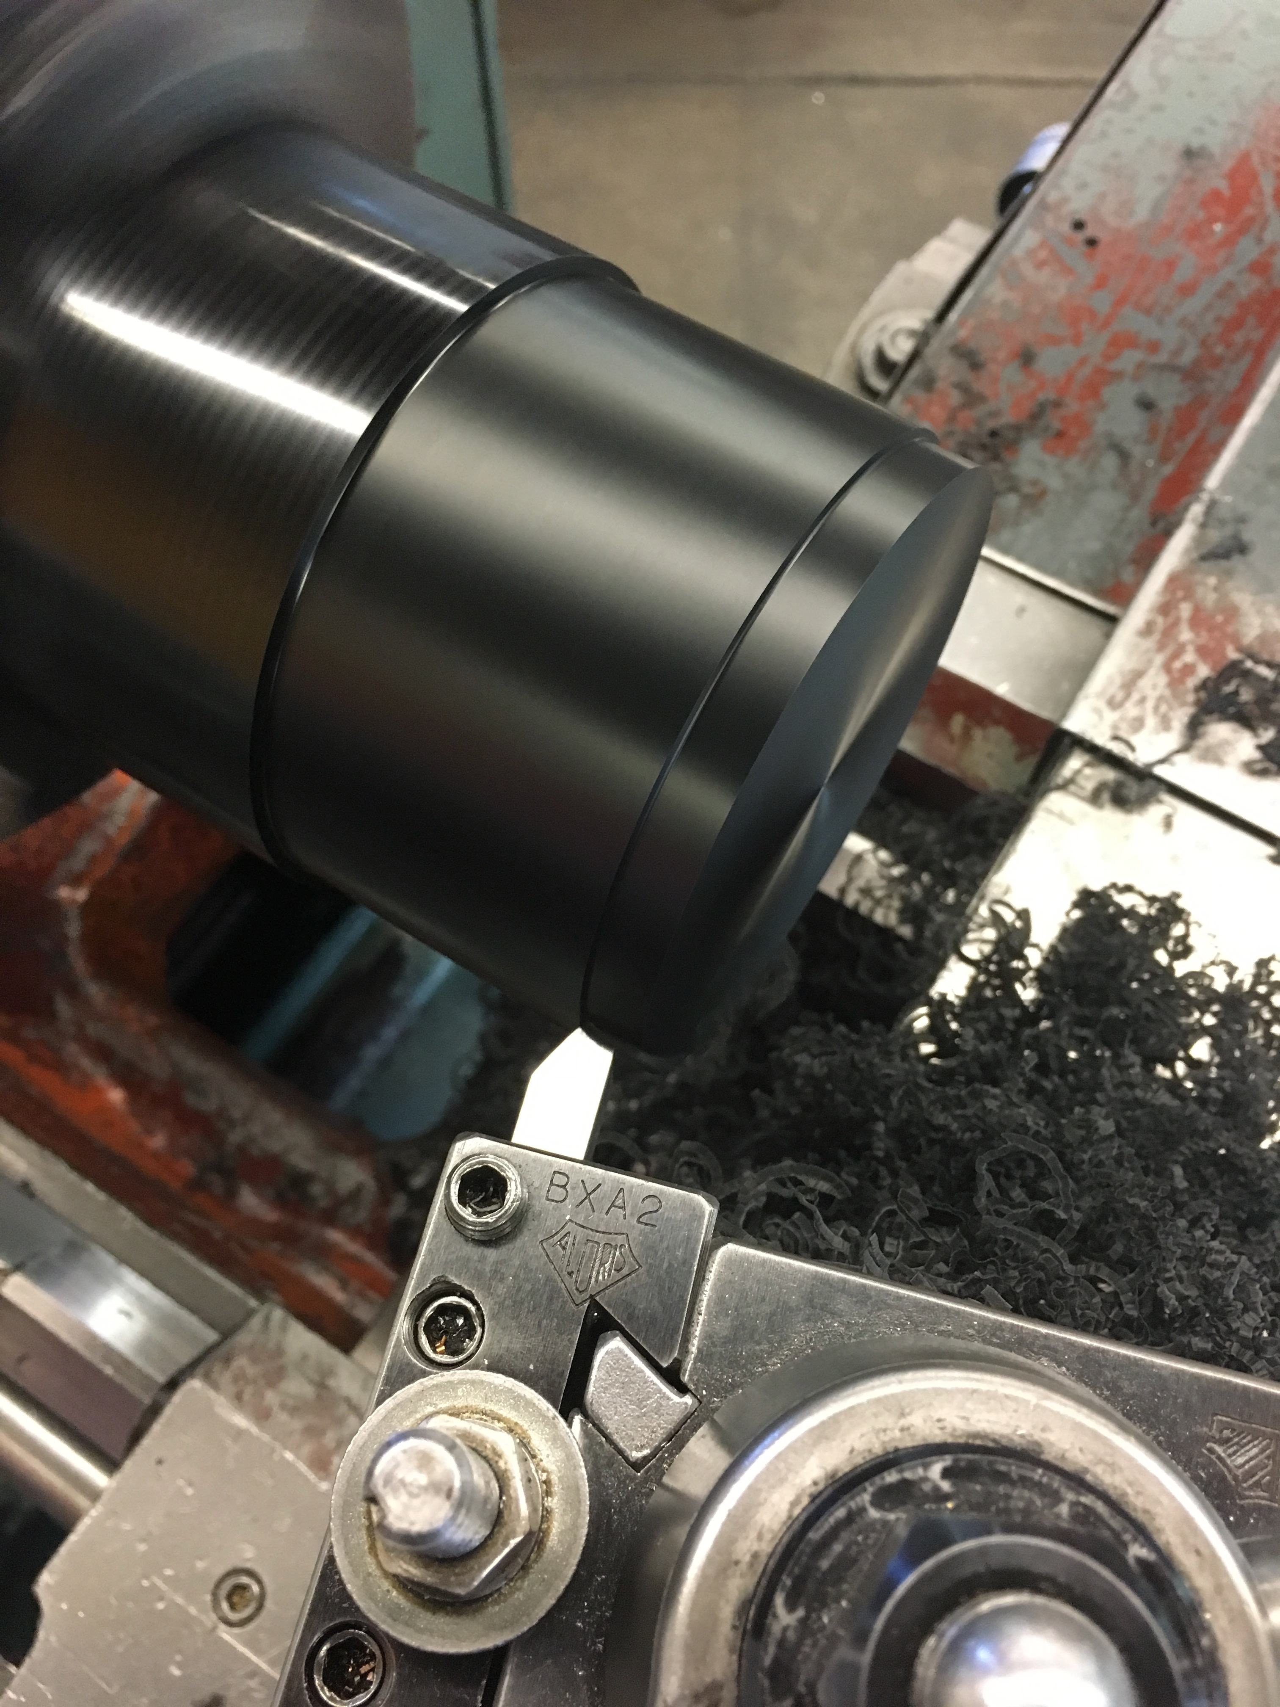
Notes:
-with the middle section shipped off to the anodizer, I worked on the top holders. And if you haven’t machined Delrin before, I recommend it, it’s very fun and the machine finish is excellent

Slide 14
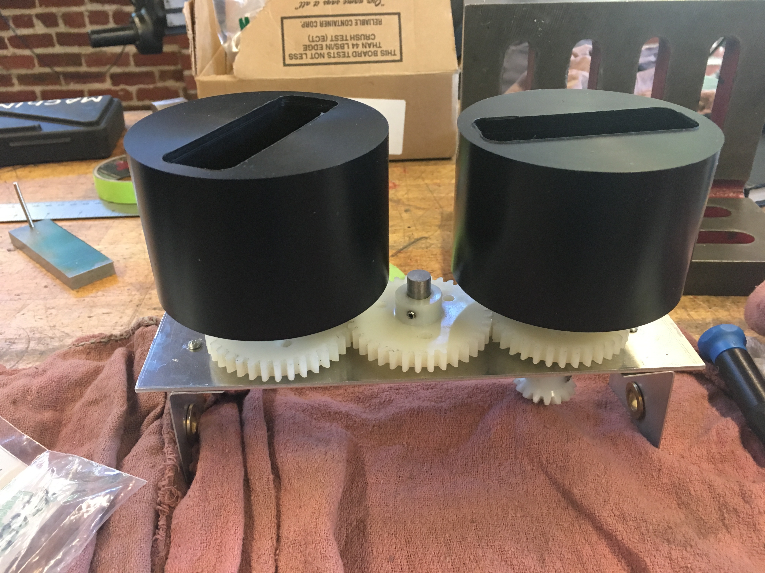
Notes:
-and here they are all finished and tested with my gear system

Slide 15
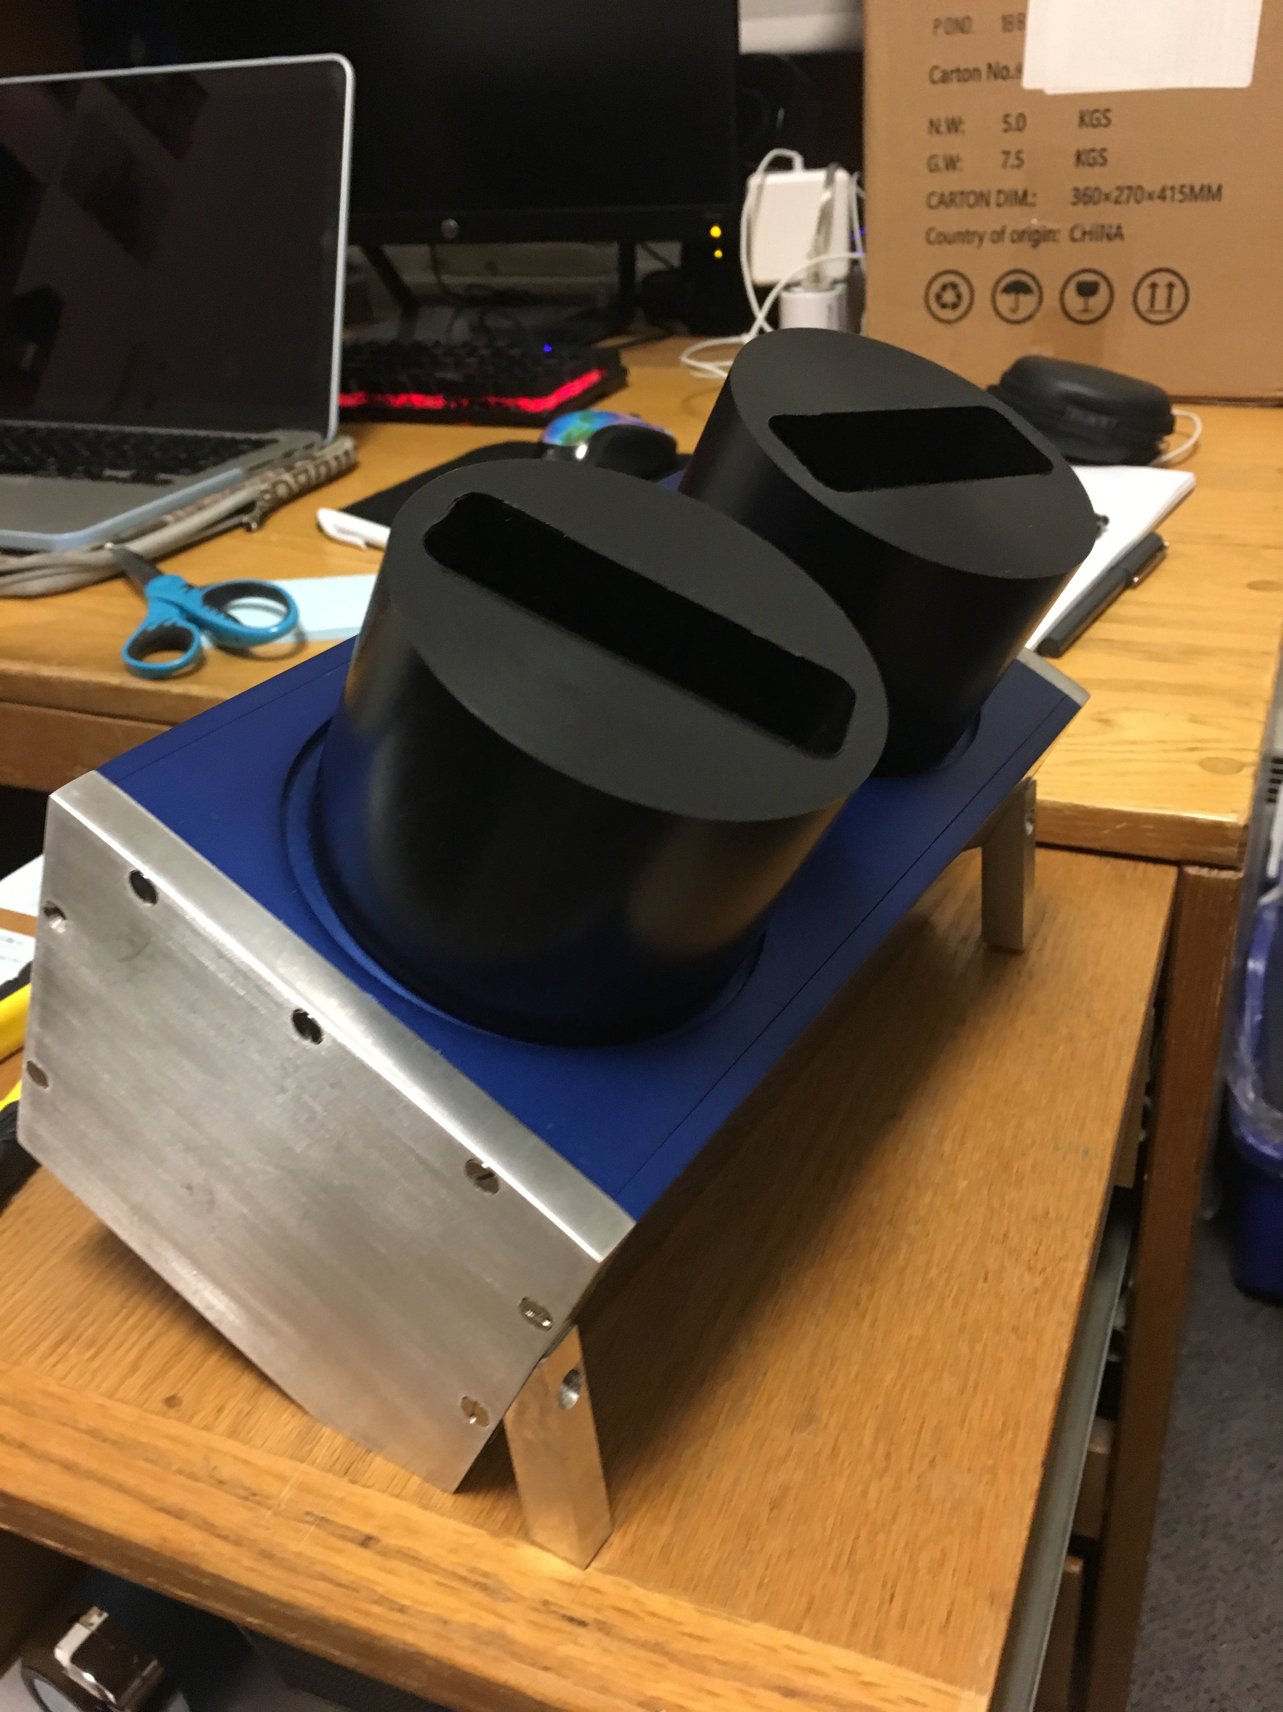
Notes:
-and the finished product, with the nice anodized parts all connected. I had to add the legs so that it was stable

Slide 16
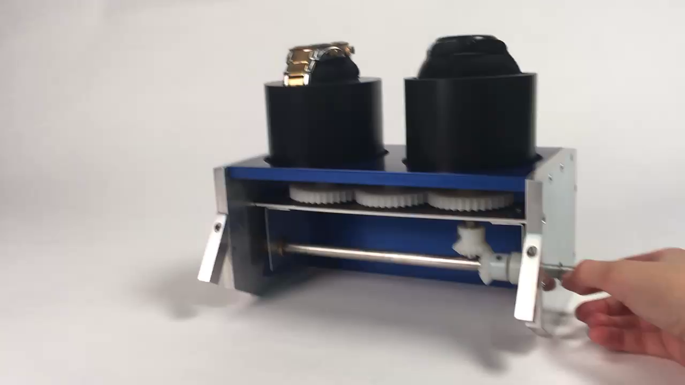

Slide 17
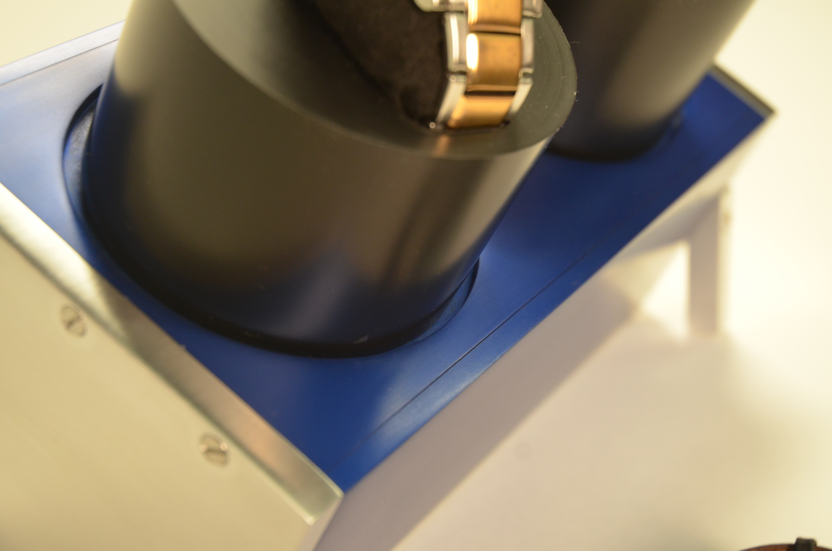
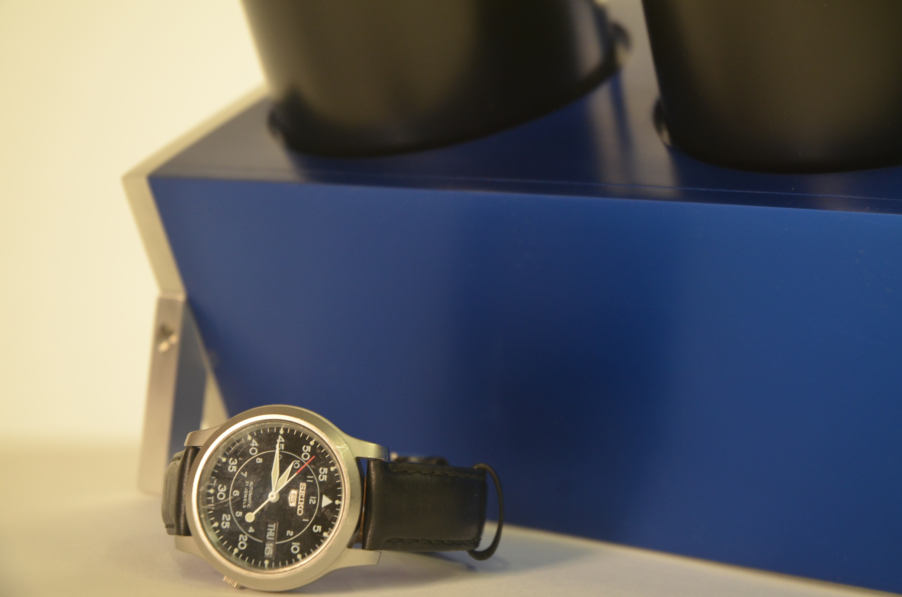
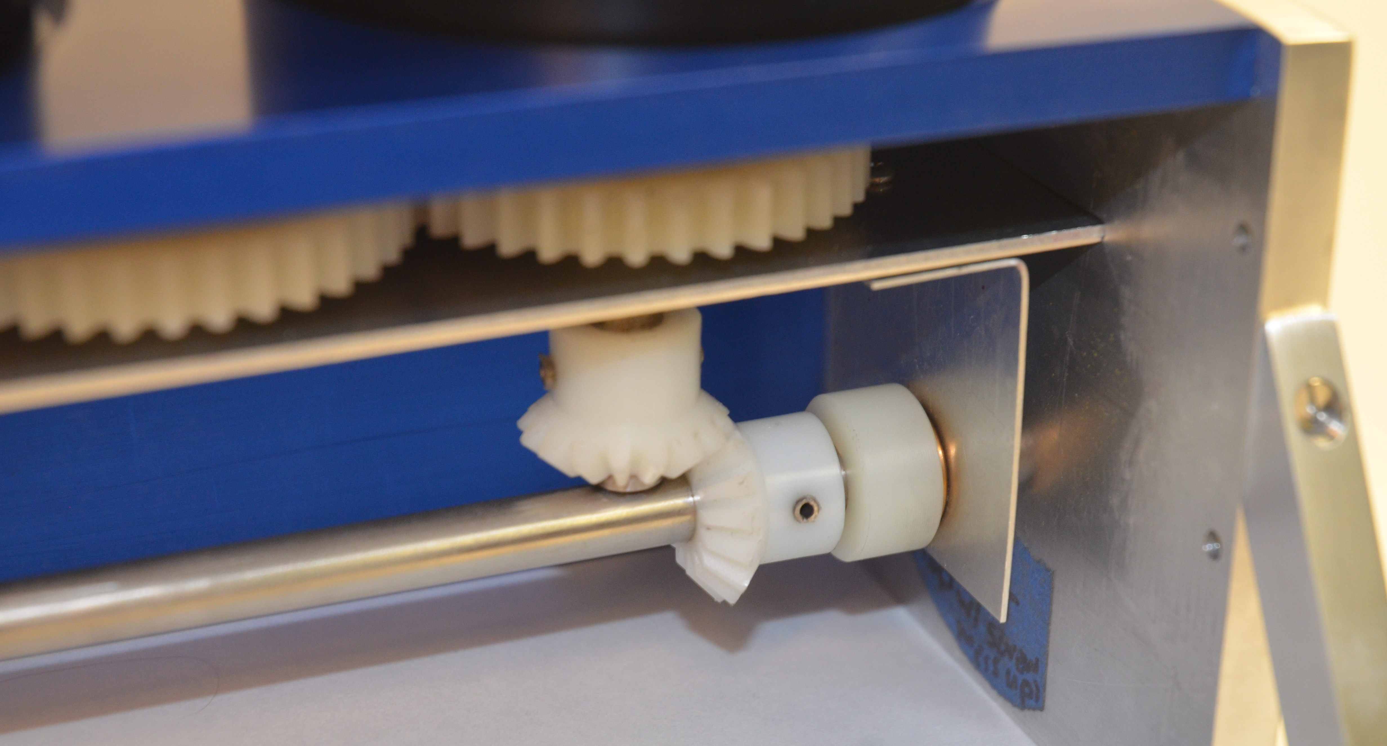
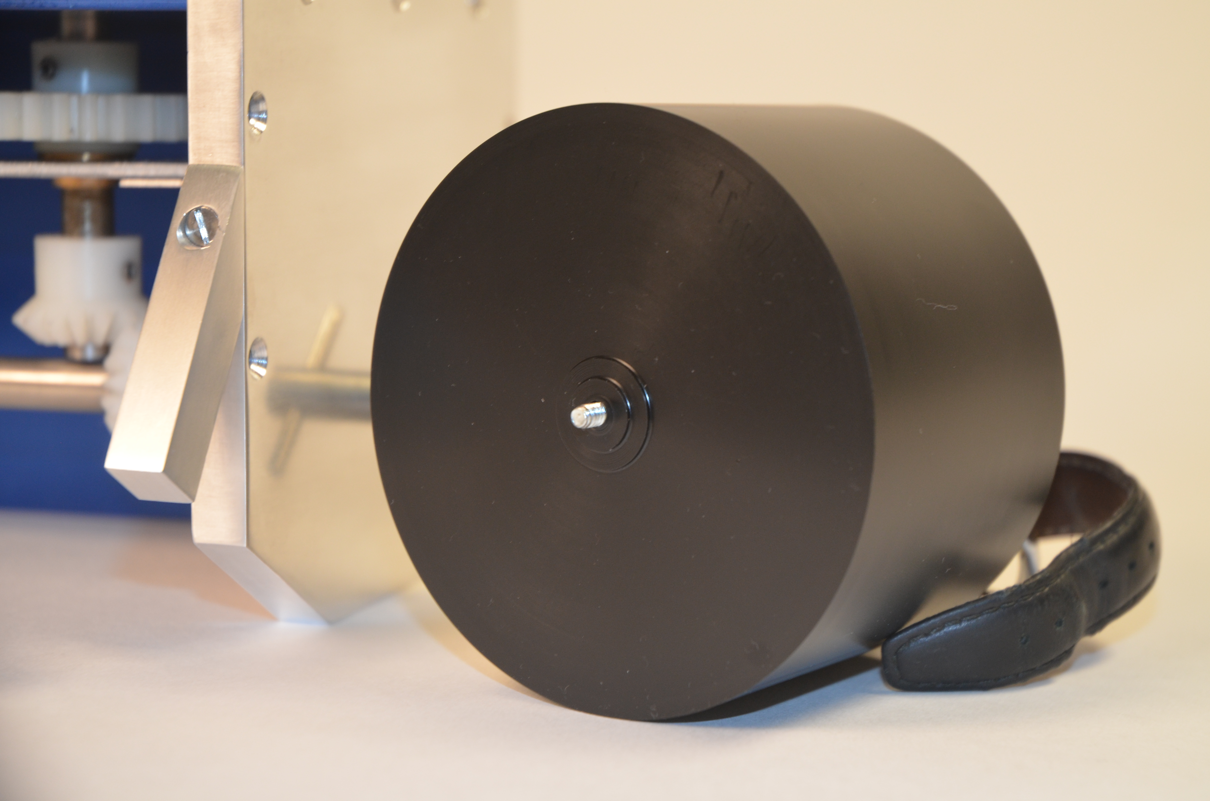
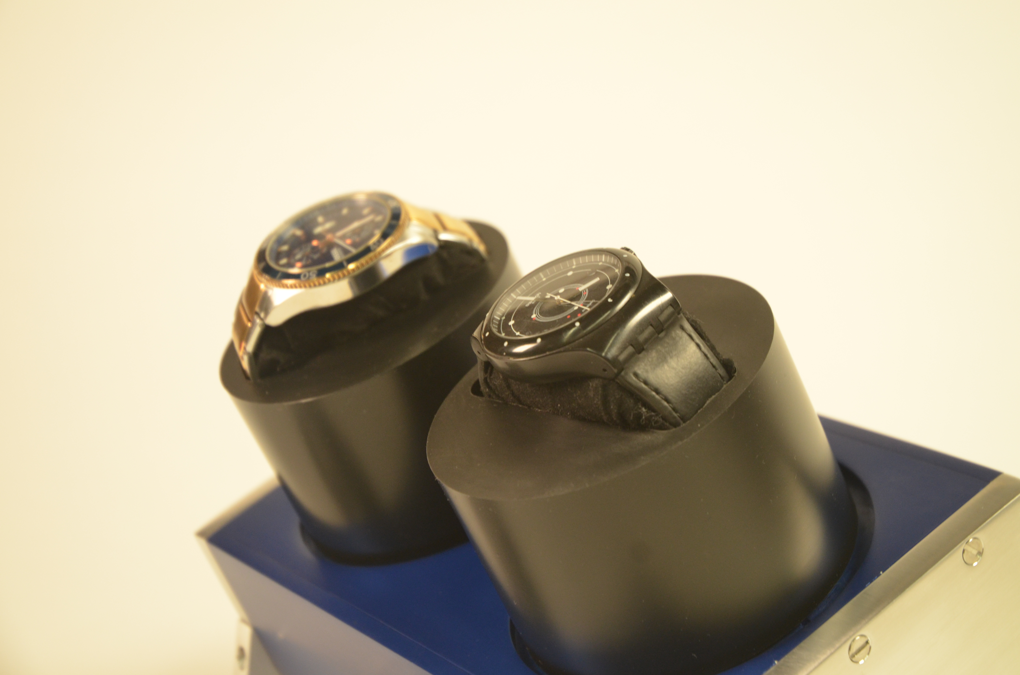
Notes:
-And some of my photoshoot pictures

Slide 18
Timekeeper
Natalie Ferrante
Notes:
-Thank you!

